Slide 1

Competitor Analysis
Robin Falconer
Aug 2021

Slide 2
OX2’s wind power portfolio A competitor analysis on wind power projects ”In Operation”
Project Scope
Scrape the development portfolio of competitors (other wind developers)
Identify project information regarding each project (total height, # turbines, production, etc)
Analyse potential trends:
Development of project fundamenta
Production development
Choice of turbine supplier
Research Questions
What is OX2’s average project?
OX2’s annual production development for wind power projects?
Does OX2 have a preferred turbine supplier?
Method
Identify parameters necessary for competitor analysis
Webscrape using Selenium & Beautiful Soup
Structure, clean & analyse the data collected

Slide 3
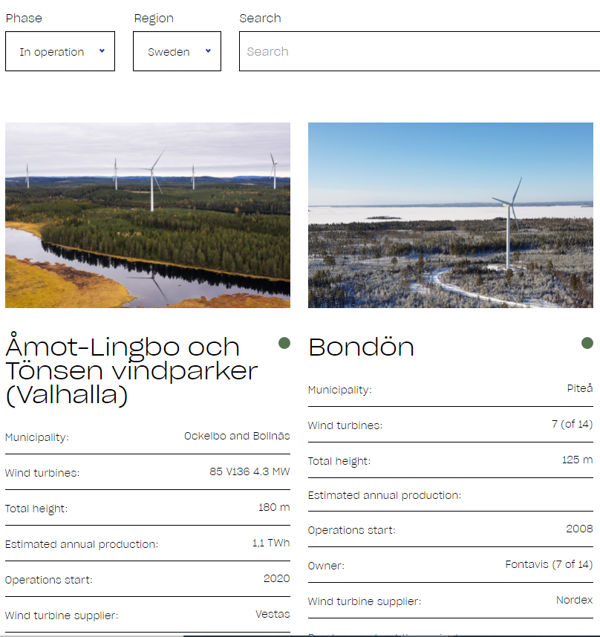
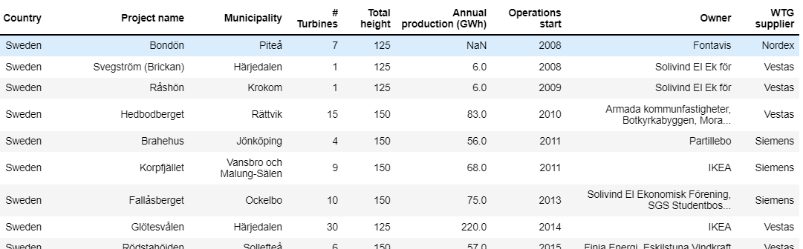
Description of data collected ”Small” but informative dataset from OX2’s project portfolio
Excerpt from website used for data collection
Data collected from webscraping
25 projects
8 different data points per project
Both hard & soft data
2 countries
3 WTG suppliers
data collected between years 2008 – 2020

Slide 4

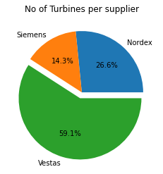
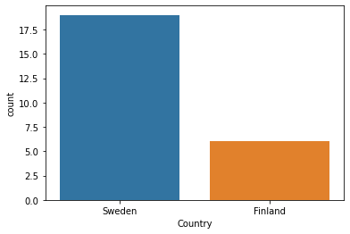
RQ: A) What is OX2’s average project? Medium sized project developed in Sweden with Vestas turbines
Avg. size of WTG | 4 MW
Avg. # of WTG | 14 turbines
Avg. annual prod. | 161 GWh
Avg. Total height | 170 m

Slide 5
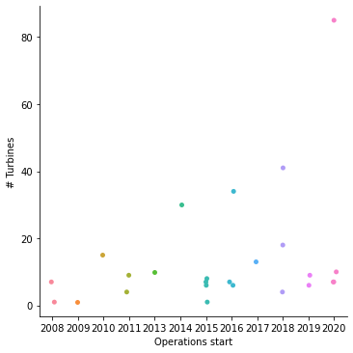
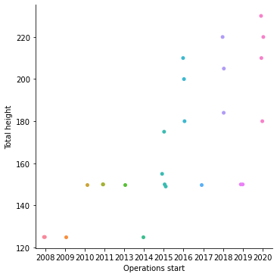
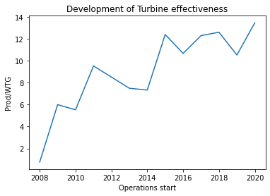
RQ: B) OX2’s production development for wind power projects? OX2 have developed higher and more effective turbines, which increase production
There seem to be no trend in the size of the developed wind power projects.
OX2 have developed wind power projects with higher ”Total height”.

Slide 6
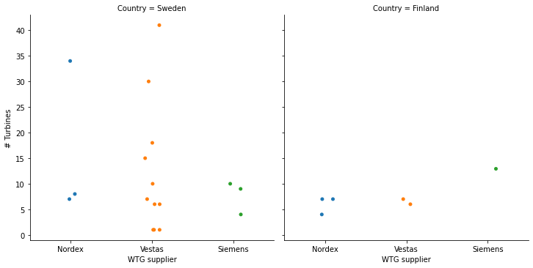
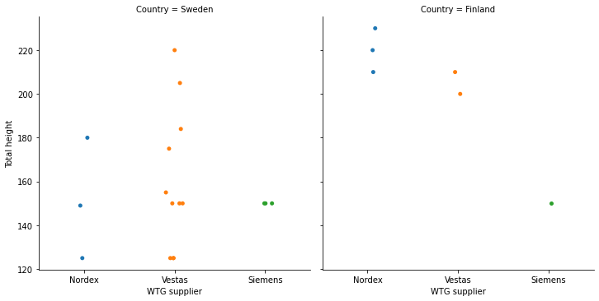
RQ: C) Does OX2 have a preferred turbine supplier?
Vestas is the preferred turbine supplier
OX2 has chosen both Vestas & Nordex for wind power projects with high “Total height”
Vestas is the most frequent chosen supplier
Vestas is not size (No of turbines) dependent

Slide 7
Challenges | Learnings | Improvements
Challenges
The webpage that was scraped proved to be more difficult to scrape, which led to a smaller dataset than was intended from the beginning of the project.
The datapoints of each project differed a bit between projects.
Learnings
Main learnings was webscraping by using Selenium and Beautiful Soup
The webpage required several functions before scraping was possible:
Drop-down lists
Scroll function
Click button to load more projects in the list
Improvements
More development stages could have been scraped/analysed
The code is applicable, although time was scarse
More competitors should be added to increase the dataset

